Slide 1

Chapter 2:
Contextual Influences on Compensation Practice

Slide 2
Learning Objectives
2-1. Discuss the reasons for interindustry wage
differentials.
2-2. Explain the factors that contribute to pay
differentials based on occupational
characteristics.
2-3. Summarize the reasons for the occurrence of
geographic pay differentials.
2-4. Discuss the role of labor unions in setting
compensation.
2-5. Identify and discuss key employment laws
pertinent to compensation practice.

Slide 3
Interindustry Wage Differentials
LO 2-1
The pattern of pay and benefits associated with characteristics of industries
Factors leading to interindustry wage differentials
Industry’s product market: Where there is little competition (e.g., mining, utilities), there is greater flexibility for providing higher wages
Capital intensity: The extent to which companies’ operations are based on the use of large-scale equipment, and capital intensity is associated with higher wages

Slide 4
Interindustry Wage Differentials
LO 2-1
Factors leading to interindustry wage differentials:
Industry profitability: Presumably, employee higher levels of knowledge, skills and abilities contribute to company profitability, which, in turn, is associated with higher wages
Unionization of the workforce: More highly unionized industries pay more highly, in part, because the collective bargaining process gives labor greater leverage for negotiating higher wages and benefits

Slide 5
Interindustry Wage Differentials
LO 2-1

Slide 6
Occupational Wage Differentials
LO 2-2
An occupation is a group of jobs, found at more than one company, characterized by a:
Common set of tasks, and related in terms of
Similar objectives
Methodologies
Materials
Products
Worker actions
Worker characteristics

Slide 7
Occupational Wage Differentials
LO 2-2
Two examples of occupations include
Office support (e.g., file clerks, clerk typists)
Human resources management (e.g., compensation analyst, training and development specialist)
Lawyers, judges, and related workers
Cooks and food preparation workers
Law enforcement workers (e.g., bailiffs, police officers)

Slide 8
Explaining Occupational Wage Differentials
LO 2-2
Job content based on knowledge, skills, and abilities (KSAs)
Labor supply relative to employer demand for labor

Slide 9
Occupational Wage Differentials: Job Content
LO 2-2
Between occupational differences
Differences in the complexity of KSAs such as
The building and grounds cleaning and maintenance occupations
Computer and mathematical occupations
Within occupational differences
Differences in KSAs within an occupational group
Pharmacy technician
Pharmacist

Slide 10
Occupational Wage Differentials: Supply and Demand
LO 2-2
When labor supply < employer demand, companies compete for limited talent
Wages are typically greater when labor supply < employer demand
Cybersecurity experts are in high demand given the continued upward trends in cyberattacks
Fast food restaurant workers are in high demand since economic conditions improved, creating higher paying alternatives, necessitating that many restaurants pay higher wages

Slide 11
Geographic Pay Differentials
LO 2-3
Relative pay differentials are often expressed as the percentage difference between a specific location and the national average
The relative pay differential for Los Angeles is 20% higher than the national average
The relative pay differential for Lincoln, Nebraska is 3 percent less than the national average

Slide 12
Geographic Pay Differentials
LO 2-3
Pay rate differentials are expressed in dollars as annual or hourly pay differences for occupations based on particular geographic regions and the nation overall
Cost-of-living differences between geographic locations influence pay
Oftentimes, average housing prices signal cost-of-living differences (e.g., $389,000 in Boston; $173,000 in Fargo, North Dakota)

Slide 13
Geographic Pay Differentials
LO 2-3
Consistency in the direction of the relative pay and pay rate differentials, but the magnitude often differs
Differences in calculation method accounts for these differences
Relative pay differentials control for the influence of other variables, for example,
Unionization of the workforce
Interindustry wage differentials

Slide 14
Labor Union Influence on Pay
LO 2-4
In general, workers represented by unions earn more, on average, than non-union workers: $970/week vs $763/week in 2014
The collective efforts of labor, organized through labor unions, have led to higher pay than in settings where pay rate negotiation is conducted between individual employees and the employer

Slide 15
Labor Union Influence on Pay
LO 2-4
The spillover effect suggests that non union employers tend to pay higher than they might otherwise pay in order to avoid unionization

Slide 16
Decline in Union Representation
LO 2-4
Since 1954 (highest union representation at 28.3%), the unionization rate has steadily declined; yet, the wage advantage still prevails
About 30 years ago, the rate was 20.3%
In 2014, union representation was at 11.1%

Slide 17
Some of the Causes for Decline in Union Representation
LO 2-4
Legislation prohibits unions from intimidating workers to become members
Right-to-work laws prohibit requiring workers to join unions as a condition of employment
Relocation of manufacturing operations from the United States to other countries with fewer labor laws

Slide 18
Four Constitutional Amendments
LO 2-5
Basis for laws:
Article 1, Section 8
Scope of Congressional powers
First Amendment
Limits to Congressional power
Fifth Amendment
Individual Rights
Fourteenth Amendment, Section 1
State governments’ limitations

Slide 19
Compensation Law Themes
LO 2-5
Four themes:
Income continuity, safety, and work hours
Pay discrimination
Accommodating disabilities and family needs
Prevailing wage laws

Slide 20
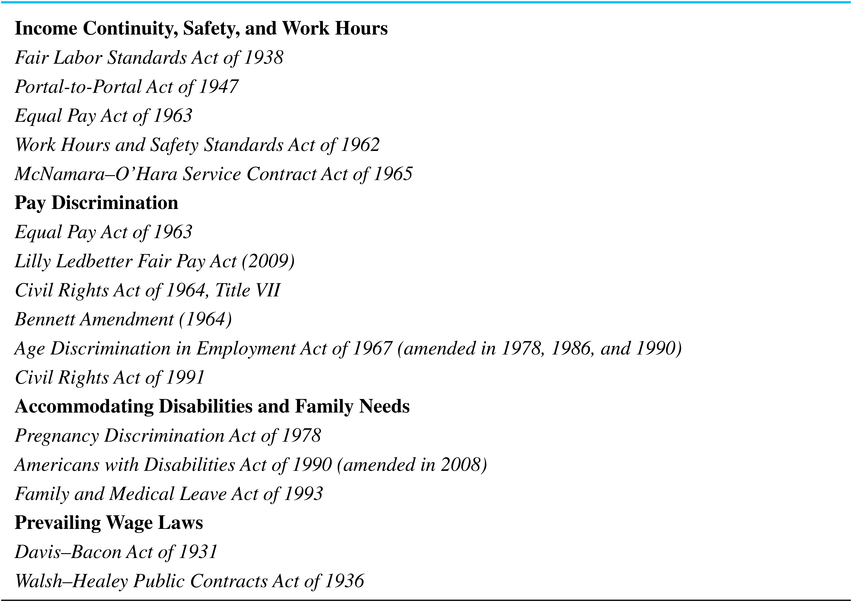
Laws Pertinent to Compensation Practice
LO 2-5

Slide 21
Laws Pertinent to Compensation Practice
LO 2-5
Additional laws focused on employee benefits:
Discretionary Benefits (Chapter 9)
Internal Revenue Code
Employee Retirement Income Security Act
Pension Protection Act
Legally-Required Benefits (Chapter 10)
Social Security Act
Workers’ compensation
Family and Medical Leave Act
Patient Protection and Affordable Care Act
Consolidated Omnibus Budget Reconciliation Act
Health Insurance Portability and Accountability Act

Slide 22
Government Units
LO 2-5
Federal → oversees the entire United States and its territories
State → enacts and enforces laws that pertain exclusively to their respective regions
Local → enacts and enforces laws that are most pertinent to smaller geographic regions

Slide 23
FLSA of 1938
LO 2-5
Federal minimum wage ($7.25/hr as of 2009)
Overtime pay (typically 1.5 times normal hourly rate for each hour beyond 40 in a workweek)
Child labor provisions

Slide 24
FLSA Exempt Positions
LO 2-5
Executive
Administrative
Learned professional
Creative professional
Computer positions
Outside sales
Most other jobs are nonexempt. Nonexempt jobs are subject to the FLSA overtime pay provision.

Slide 25
FLSA Exemption Criteria
LO 2-5
Executive | Management of the enterprise or a recognized department or subdivision
Administrative | Performing office or nonmanual work directly related to the management or general business operations of the employer or employer’s customers
Learned professional | Performing office or nonmanual work requiring knowledge of an advanced type in a field of science or learning, customarily acquired by a prolonged course of specialized intellectual instruction
Creative professional | Performing work requiring invention, imagination, originality, or talent in a recognized field of artistic or creative endeavor
Computer | Employed as a computer systems analyst, computer programmer, software engineer, or other similarly skilled worker in the computer field
Outside sales | Making sales or obtaining orders or contracts for services or for future use of facilities for which a consideration will be paid by the client or customer; customarily and regularly engaged a way from the employer’s place or places of business

Slide 26
Compensable Work Activities
LO 2-5
Waiting time
On-call time
Rest and meal periods
Sleeping time and certain other activities
Lectures, meetings, and training programs
Travel time
Home to work travel
Home to work on special one day assignment
Travel that is all in a day’s work
Travel away from home community

Slide 27
Child Labor
LO 2-5
Ages 14 and younger can’t work
Ages 14 and 15 can work
3 hours on school nights
18 hours per week when school is in
40 hours per week when school is out
Ages 16 and 17
No hourly restrictions
Can’t work in hazardous conditions

Slide 28
Equal Pay Act of 1963
LO 2-5
Broadened FLSA
Enforced by EEOC
Prohibited sex discrimination
Defined compensable factors
Established legal pay differentials

Slide 29
Compensable Factors
LO 2-5
Factor | Definition
Skill | Experience, training, education, and ability as measured by the performance requirements of a job
Effort | The amount of mental or physical effort expended in the performance of a job
Responsibility | The degree of accountability required in the performance of a job
Working conditions | The physical surrounding and hazards of a job, including dimensions such as inside versus outside work, heat, cold, and poor ventilation

Slide 30
Legal Pay Differentials
LO 2-5
Payments made pursuant to a:
Seniority system
Merit system
Earnings measured by quantity or quality of production
Differentials not based on gender

Slide 31
Civil Rights Act of 1964 (Title VII)
LO 2-5
Promotes equal employment opportunities for minorities
Defined two types of discrimination
Disparate treatment → intentional discrimination
Disparate impact → unintentional discrimination

Slide 32
Title VII Discrimination
LO 2-5
Disparate treatment
Intentional
Workers treated unfairly because of race, color, religion, gender, national origin
Ex: Different standards to determine pay increases for African American and White employees.

Slide 33
Title VII Discrimination
LO 2-5
Disparate impact
Unintentional
Unequal treatment of protected employee groups
Ex: Awarding pay increases to male and female workers based on seniority when females consistently have less seniority than men.

Slide 34
Equal Pay for Women
LO 2-5
Lilly Ledbetter Fair Pay Act
Overturned the 2007 Ledbetter Supreme Court ruling
Helps close the pay gap between men and women
Pay discrimination charge must simply be filed within 180 days of a discriminatory paycheck

Slide 35
Equal Pay for Women (cont’d)
LO 2-5
Paycheck Fairness Act
Strengthens the remedies available to put sex-based pay discrimination on par with race-based pay discrimination
Prohibits employers from retaliating against employees who share salary information with their coworkers

Slide 36
Bennett Amendment (amendment to Title VII)
LO 2-5
Allows female employees to charge employers with Title VII violations regarding pay only when the employer has violated the Equal Pay Act of 1963.

Slide 37
ADEA of 1967
LO 2-5
Amended 1978, 1986, and 1990
Enforced by EEOC
Protection for workers age 40+ in all employment decisions
Eliminated minimum retirement age with a few exceptions such as for jobs where public safety is at issue

Slide 38
Older Workers Benefit Protection Act
LO 2-5
Under particular circumstances, employers may require older employees to pay more for health care, disability, or life insurance
This is the case because these benefits cost more for older workers (e.g., an older worker may be more likely to become ill)
Charging more cannot be a condition of employment
Older workers could choose lower, less costly levels of coverage

Slide 39
Civil Rights Act of 1991
LO 2-5
Shifts burden of proof of disparate impact to employers
Filing of discrimination claims changed
U.S. citizens working overseas may file suit against U.S. businesses for discriminatory employment practices
Extends coverage to U.S. Senate employees and executive branch political appointees

Slide 40
Pregnancy Discrimination Act of 1978 (PDA)
LO 2-5
Amendment to Title VII
Prohibits disparate impact of pregnancy
Pregnancy treated like disability
The protected rights include
Credit for previous service
Accrued retirement benefits
Accumulated seniority

Slide 41
Americans with Disabilities Act of 1990 (ADA)
LO 2-5
Prohibits discrimination of employees with disabilities
Reasonable accommodations such as:
Making existing facilities readily accessible
Job restructuring
Modifying work schedules
Defines “qualified individuals with disabilities”
Enforced by the EEOC

Slide 42
ADA Amendments Act of 2008
LO 2-5
Expands the definition of major life activities
Mitigating measures other than “ordinary eyeglasses or contact lenses” shall not be considered in assessing whether an individual has a disability
Clarifies that an impairment that is episodic or in remission is a disability if it would substantially limit a major life activity when active

Slide 43
Family and Medical Leave Act of 1993 (FMLA)
LO 2-5
Job protection during family and medical emergencies
Guarantees unpaid leave
Employee returns with same or similar
Position
Pay
Conditions
Benefits

Slide 44
Davis-Bacon Act
LO 2-5
Standards for contractors with federal contracts
Applies to on-site laborers and mechanics
Must pay prevailing wages
Must offer comparable benefits

Slide 45
Walsh–Healey Public Contracts Act
LO 2-5
Covers contractors and manufacturers who sell supplies, materials, and equipment to the federal government
Coverage is more extensive than Davis–Bacon Act
Applies to both construction and non construction activities

Slide 46

All rights reserved. No part of this publication may be reproduced, stored in a retrieval system, or transmitted, in any form or by any means, electronic, mechanical, photocopying, recording, or otherwise, without the prior written permission of the publisher. Printed in the United States of America.

